Slide 1
﻿An Integrated Framework for Applying LLMs with Custom Metrics
—— a Use Case in Personalized Study Plan Generation
PRESENTED BY Christopher Winter & Ying Zeng
12/17/2024

Slide 2
CONTENTS
I Problem Statement
II Major Contribution
III Evaluation
IV Limitations and Perspectives

Slide 3
1
PROBLEM STATEMENT

Slide 4
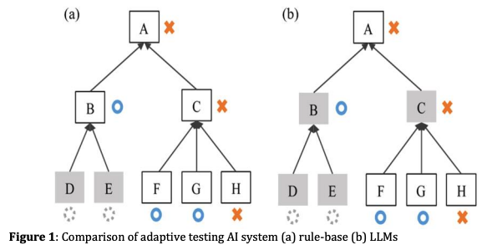
BACKGROUND
Personalized Learning
Existed Methods
Rule-Based and Delicated Annotations
One-Fits-All Teaching
Customized Teaching
﻿[1] B.-C. Kuo, et al, ”Leveraging LLMs for Adaptive Testing and Learning in Taiwan Adaptive Learning Platform (TALP),” 2023.

Slide 5
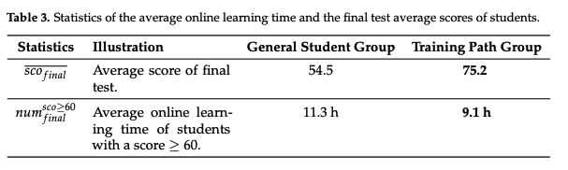
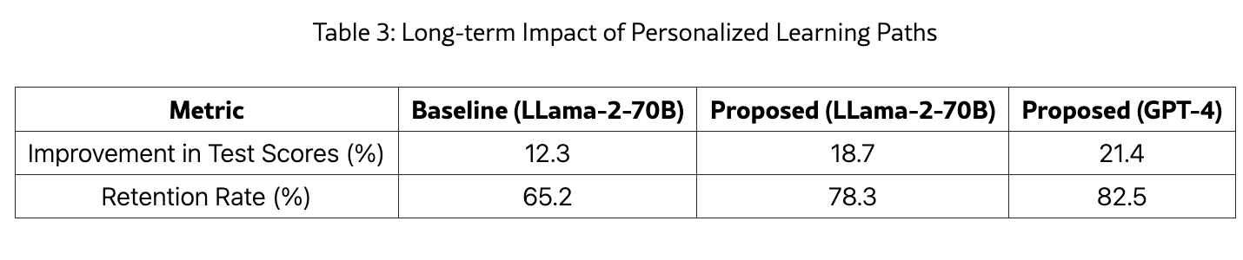
RESEARCH QUESTIONS
Challenges
[ Lack of Dataset ]
INTERNAL DATA obtained by Educational Platforms/Schools
[ Lack of Metrics ]
IN-PLATFORM retention rate or student satisfaction rate or test score improvements
﻿[2] ﻿B. Jiang, et al. ”Datadriven personalized learning path planning based on cognitive diagnostic assessments in MOOCs”. 2022.
[3] ﻿C. Ng and Y. Fung, “Educational Personalized Learning Path Planning with Large Language Models”. 2024

Slide 6
RESEARCH QUESTIONS
Questions
How to Systematically Evaluate LLMs Generated Responses Regarding Generalized Real-World Problems
Application
[ E-Commerce ]
What is A Good Dialogue Summarization
……
Innumerous Real-World Domains
[ Education ]
What is A Good Study Plan
[ Recommendation ]
What is A Good Query Recommendation

Slide 7
2
MAJOR
CONTRIBUTIONS

Slide 8
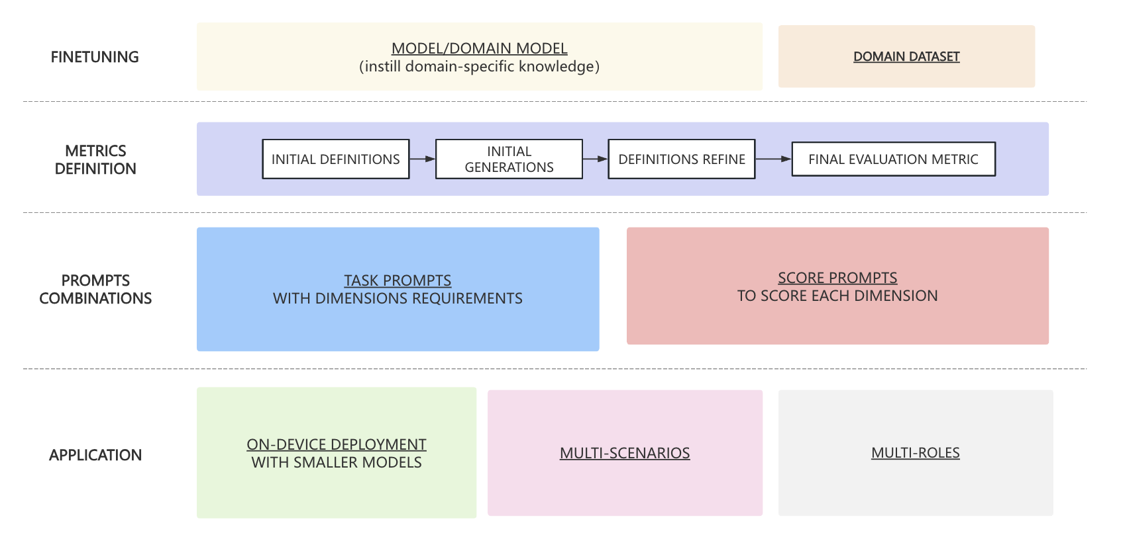
Custom Evaluation Metrics
Integrated LLM Application Framework

Slide 9
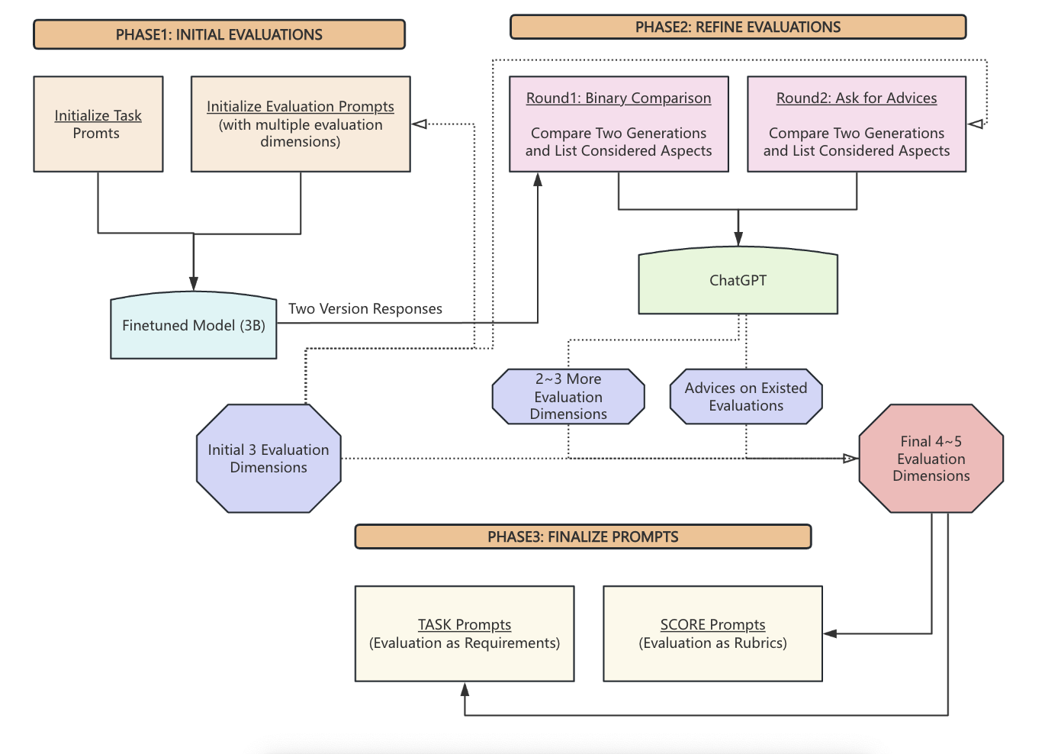
EVALUATIONS
GENERATION
PROCEDURE

Slide 10
3
EVALUATIONS

Slide 11

QUANTATIVE
METRICS
Dataset: GSM8K (Math)
Framework: Unsloth (LoRA+Quantization)
Model: Llama-3B
MODELS | ACCURACY
Finetuned Model | 0.635
Llama-3B-Instruct | 0.735
Llama-1B-Instruct | 0.295

Slide 12
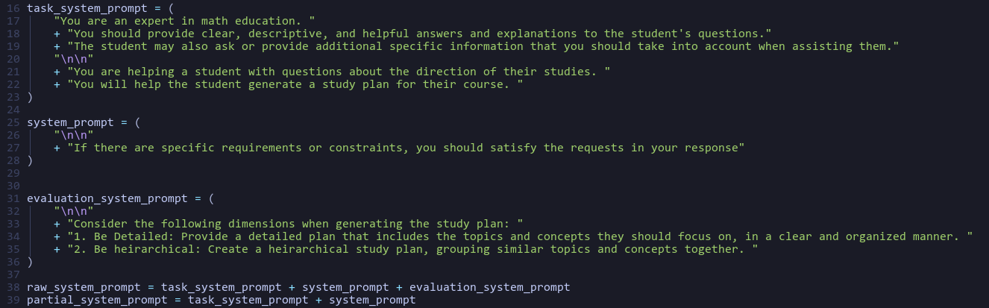
Use Case
PHASE1: INITIAL EVALUATIONS

Slide 13
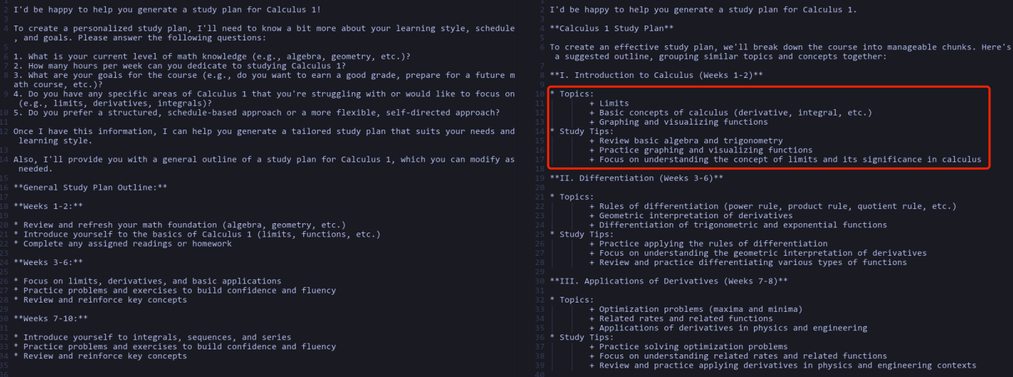
PHASE1: INITIAL EVALUATIONS

Slide 14
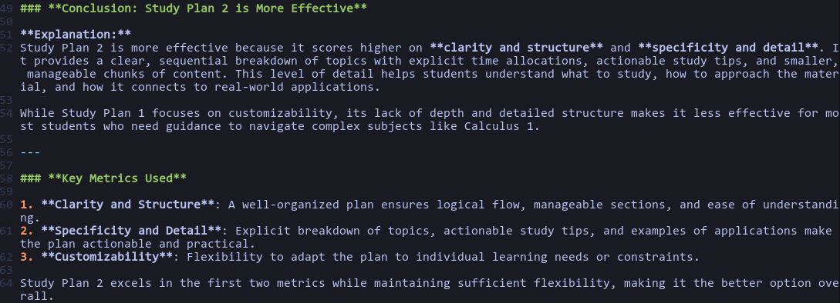
PHASE2｜REFINE EVALUATIONS
Round1: Compare and Expand Evaluations Dimensions

Slide 15
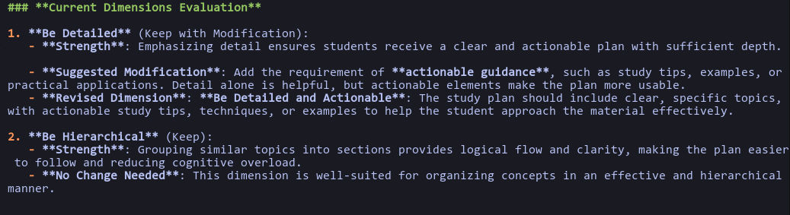
PHASE2｜REFINE EVALUATIONS
Round2: Get Advices on Existed Evaluations

Slide 16
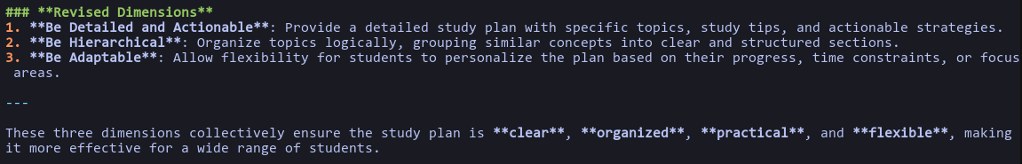
PHASE2｜REFINE EVALUATIONS
Round2: Get Advices on Existed Evaluations

Slide 17
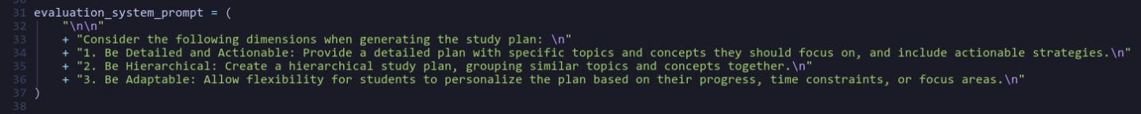
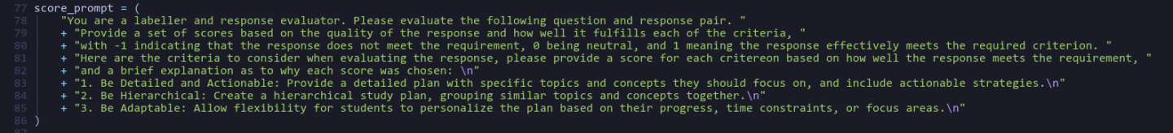
PHASE3｜FINALIZED EVALUATIONS
Evaluation Prompt
Score Prompt

Slide 18
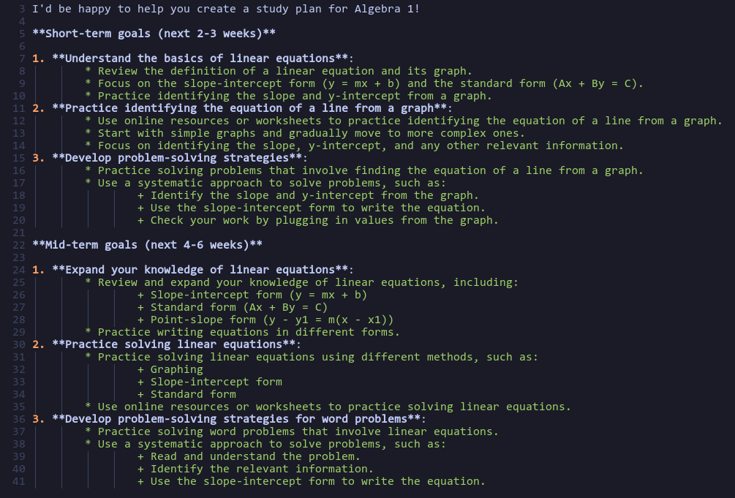
MULTIPLE SCENARIOS
Student
Can you generate a study plan for me? I am taking Algebra 1 this semester and struggling with determining the equation of a line given a graph.

Slide 19
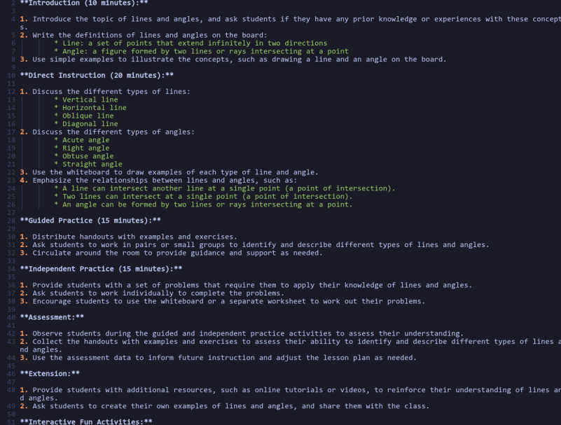
MULTIPLE SCENARIOS
Teacher
Can you generate a plan for a lecture I will be teaching? I will be teaching a Geometry course next semester. What should I cover in the lecture introducing lines and angles and the relationships between them?
Framework
Reuse Built-in Evaluation Prompts for similar tasks

Slide 20
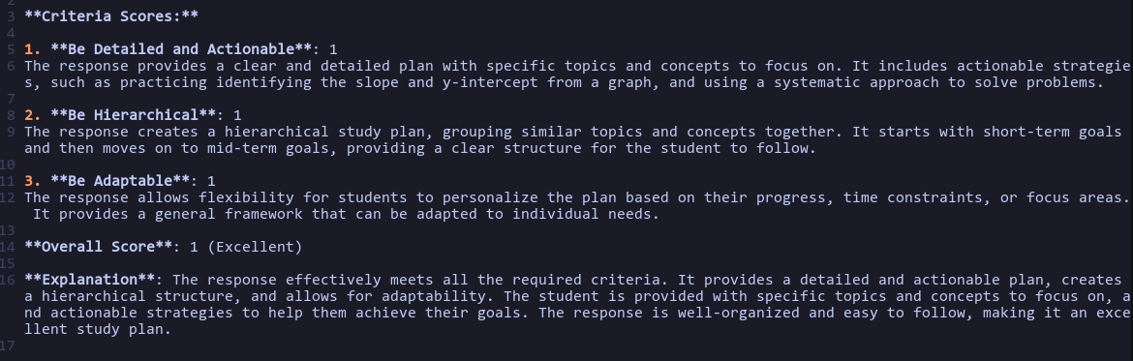
Score Prompt Application
Filter Bad Quality Responses
Labeler for Training Datasets

Slide 21
4
LIMITATIONS & PERSPECTIVES

Slide 22
LIMITATIONS
& PERSPECTIVES
Limitations
Perspectives
[ Verification on Other Domains ]
Math domain is well covered during the pretrained phase of existing LLMs.
The framework effectiveness of current use case is insufficient to demonstrate effectiveness
[ Enrich Score Level ]
Based on DIMENSIONS PRIORITY refine scoring criteria and enrich
[ Enrich Built-in Evaluations ]
Provide PLUG-IN Application and ROUTE GATE for evaluating different tasks

Slide 23
THANKS
REFERENCES:
﻿[1] B.-C. Kuo, et al, ”Leveraging LLMs for Adaptive Testing and Learning in Taiwan Adaptive Learning Platform (TALP),” 2023.
﻿[2] ﻿B. Jiang, et al. ”Datadriven personalized learning path planning based on cognitive diagnostic assessments in MOOCs”. 2022.
[3] ﻿C. Ng and Y. Fung, “Educational Personalized Learning Path Planning with Large Language Models”. 2024
GITHUB Link: LLM-for-Study-Plan
https://github.com/WIN0624/LLM-for-Study-Plan

